Slide 1
TCIABrowser Module in 3D Slicer
User Guide

Slide 2
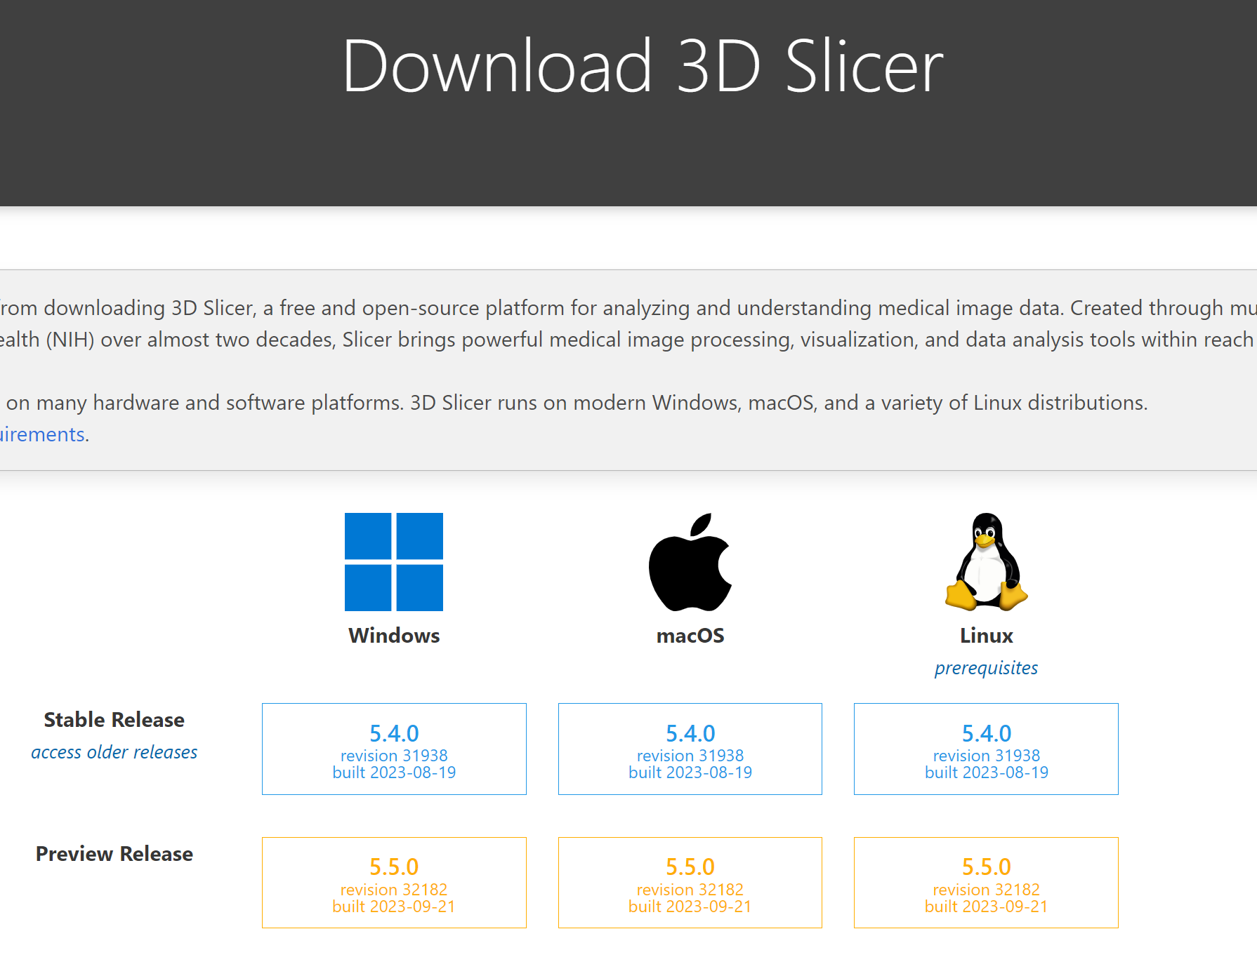
Install 3D Slicer
3D Slicer is a free, open source software for visualization, processing, segmentation, registration, and analysis of medical, biomedical, and other 3D images and meshes; and planning and navigating image-guided procedures.
You can download 3D Slicer software at: https://download.slicer.org/
The TCIA Browser extension works with stable and preview releases.

Slide 3
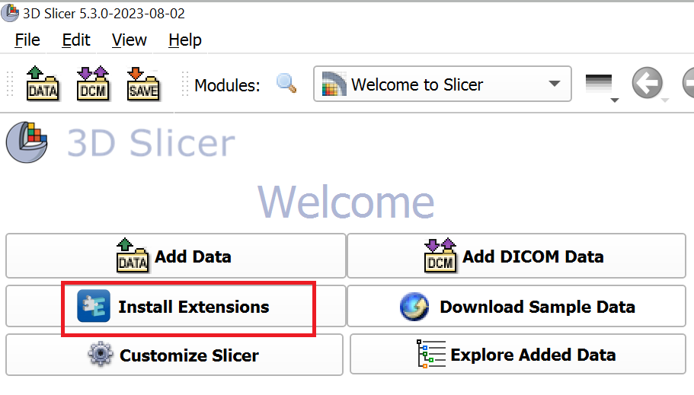
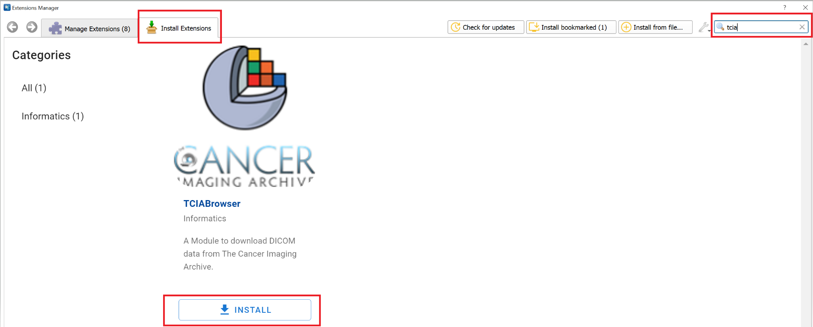
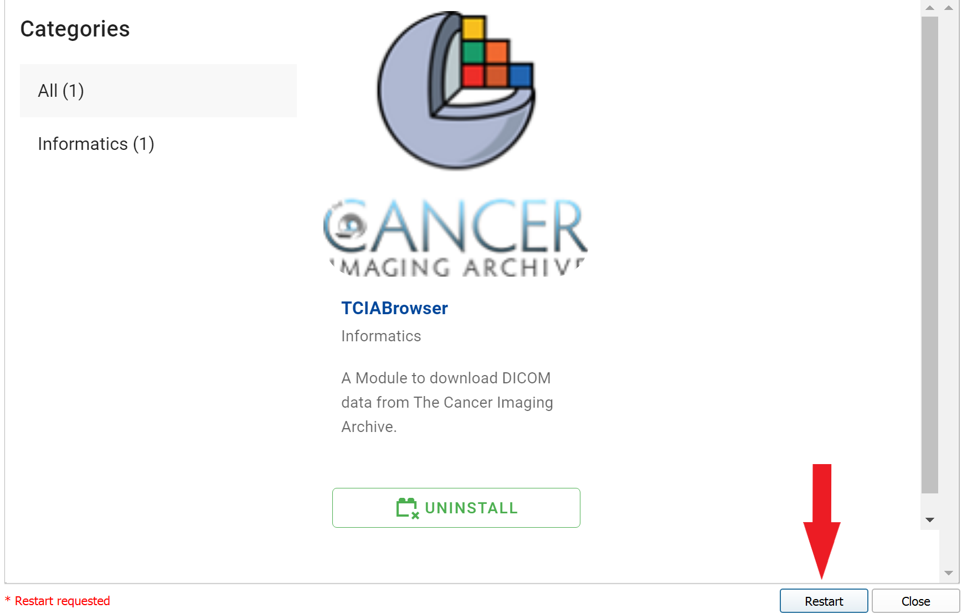
Install TCIABrowser Module
Open 3D Slicer and select Install Extensions.
2. Type “TCIA” in the search bar (top right), then click on Install.
Click on Restart to complete
the process.
TCIABrowser allows users to access DICOM datasets from The Cancer Imaging Archive and download them directly into 3D Slicer.
You can install it through Slicer’s Extension Manager using the steps on the right.
More information can be found in the TCIA Browser Documentation.

Slide 4
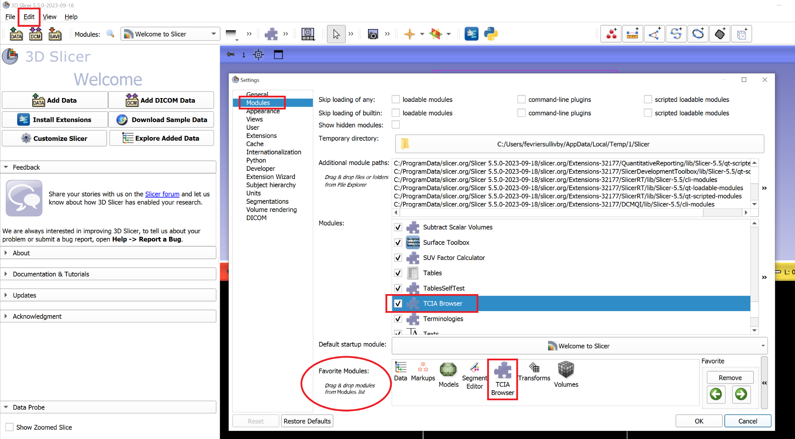
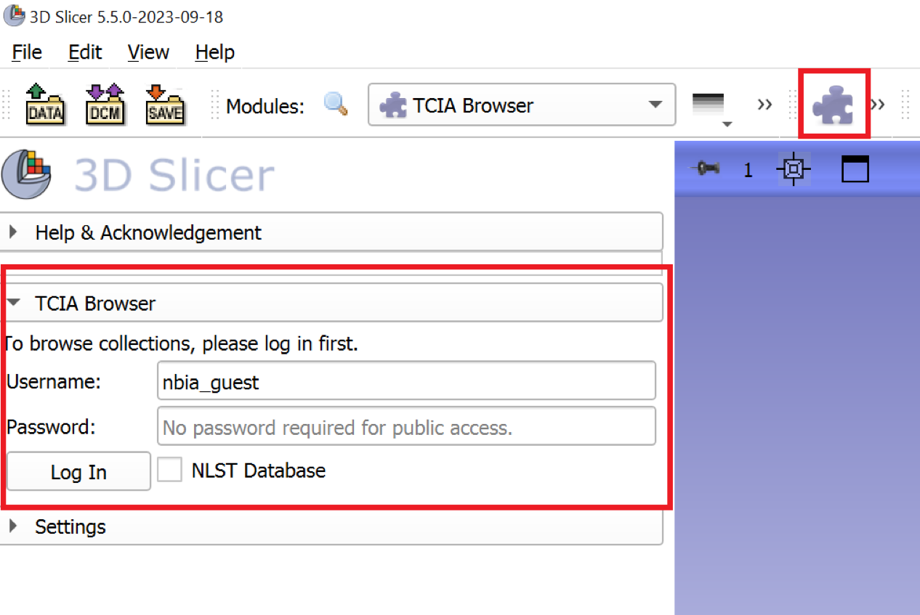
Add TCIABrowser to your Favorites toolbar
Most users will be switching frequently between TCIABrowser and other Slicer modules, so we recommend adding it to your Favorites toolbar for quicker access.
Click on Edit, then Application Settings from the dropdown menu
In the Application Settings window select Modules
Click on the TCIABrowser from the modules list and drag the icon into the “Favorite Modules” area
Click on OK. The module will be added to your favorites menu
To launch, simply click on the TCIABrowser icon
Clicking the icon will open the module on the left side of your screen

Slide 5
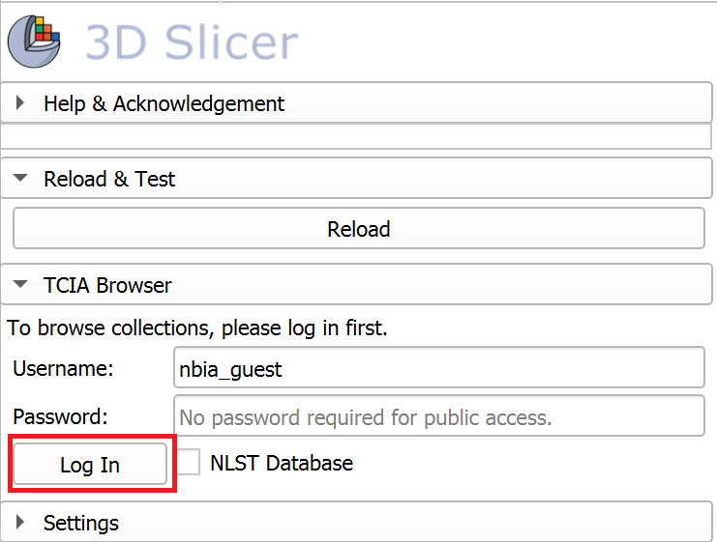
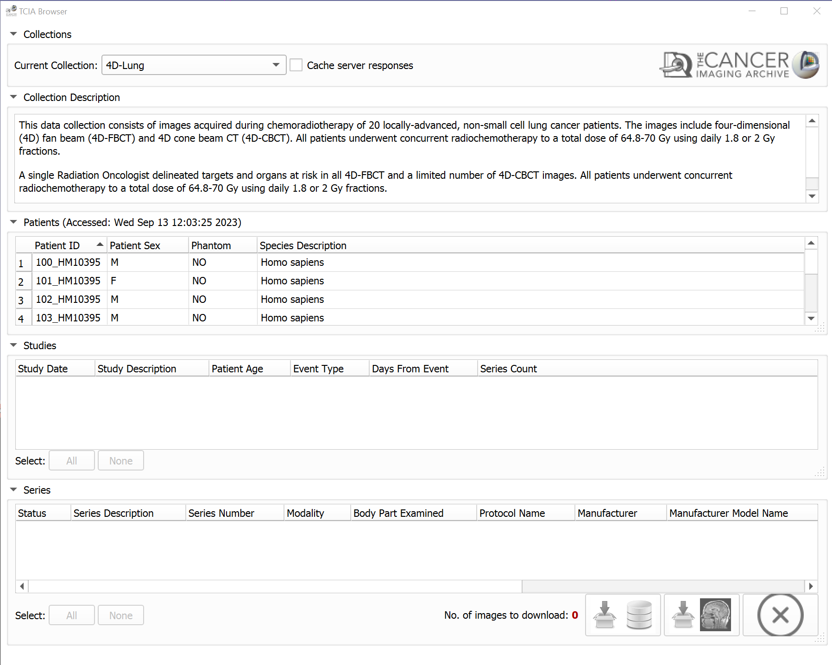
Launch TCIA Browser
To launch the browser click on the Log In button.
Passwords are not required for public access collections
Selecting the NLST checkbox will allow you to access the public National Lung Screening Trial collection, which is hosted on a separate server due to how big it is
To access restricted collections enter your TCIA username and password
The TCIABrowser will open a separate window.
Note: There may be a short delay while the datasets are loaded.

Slide 6
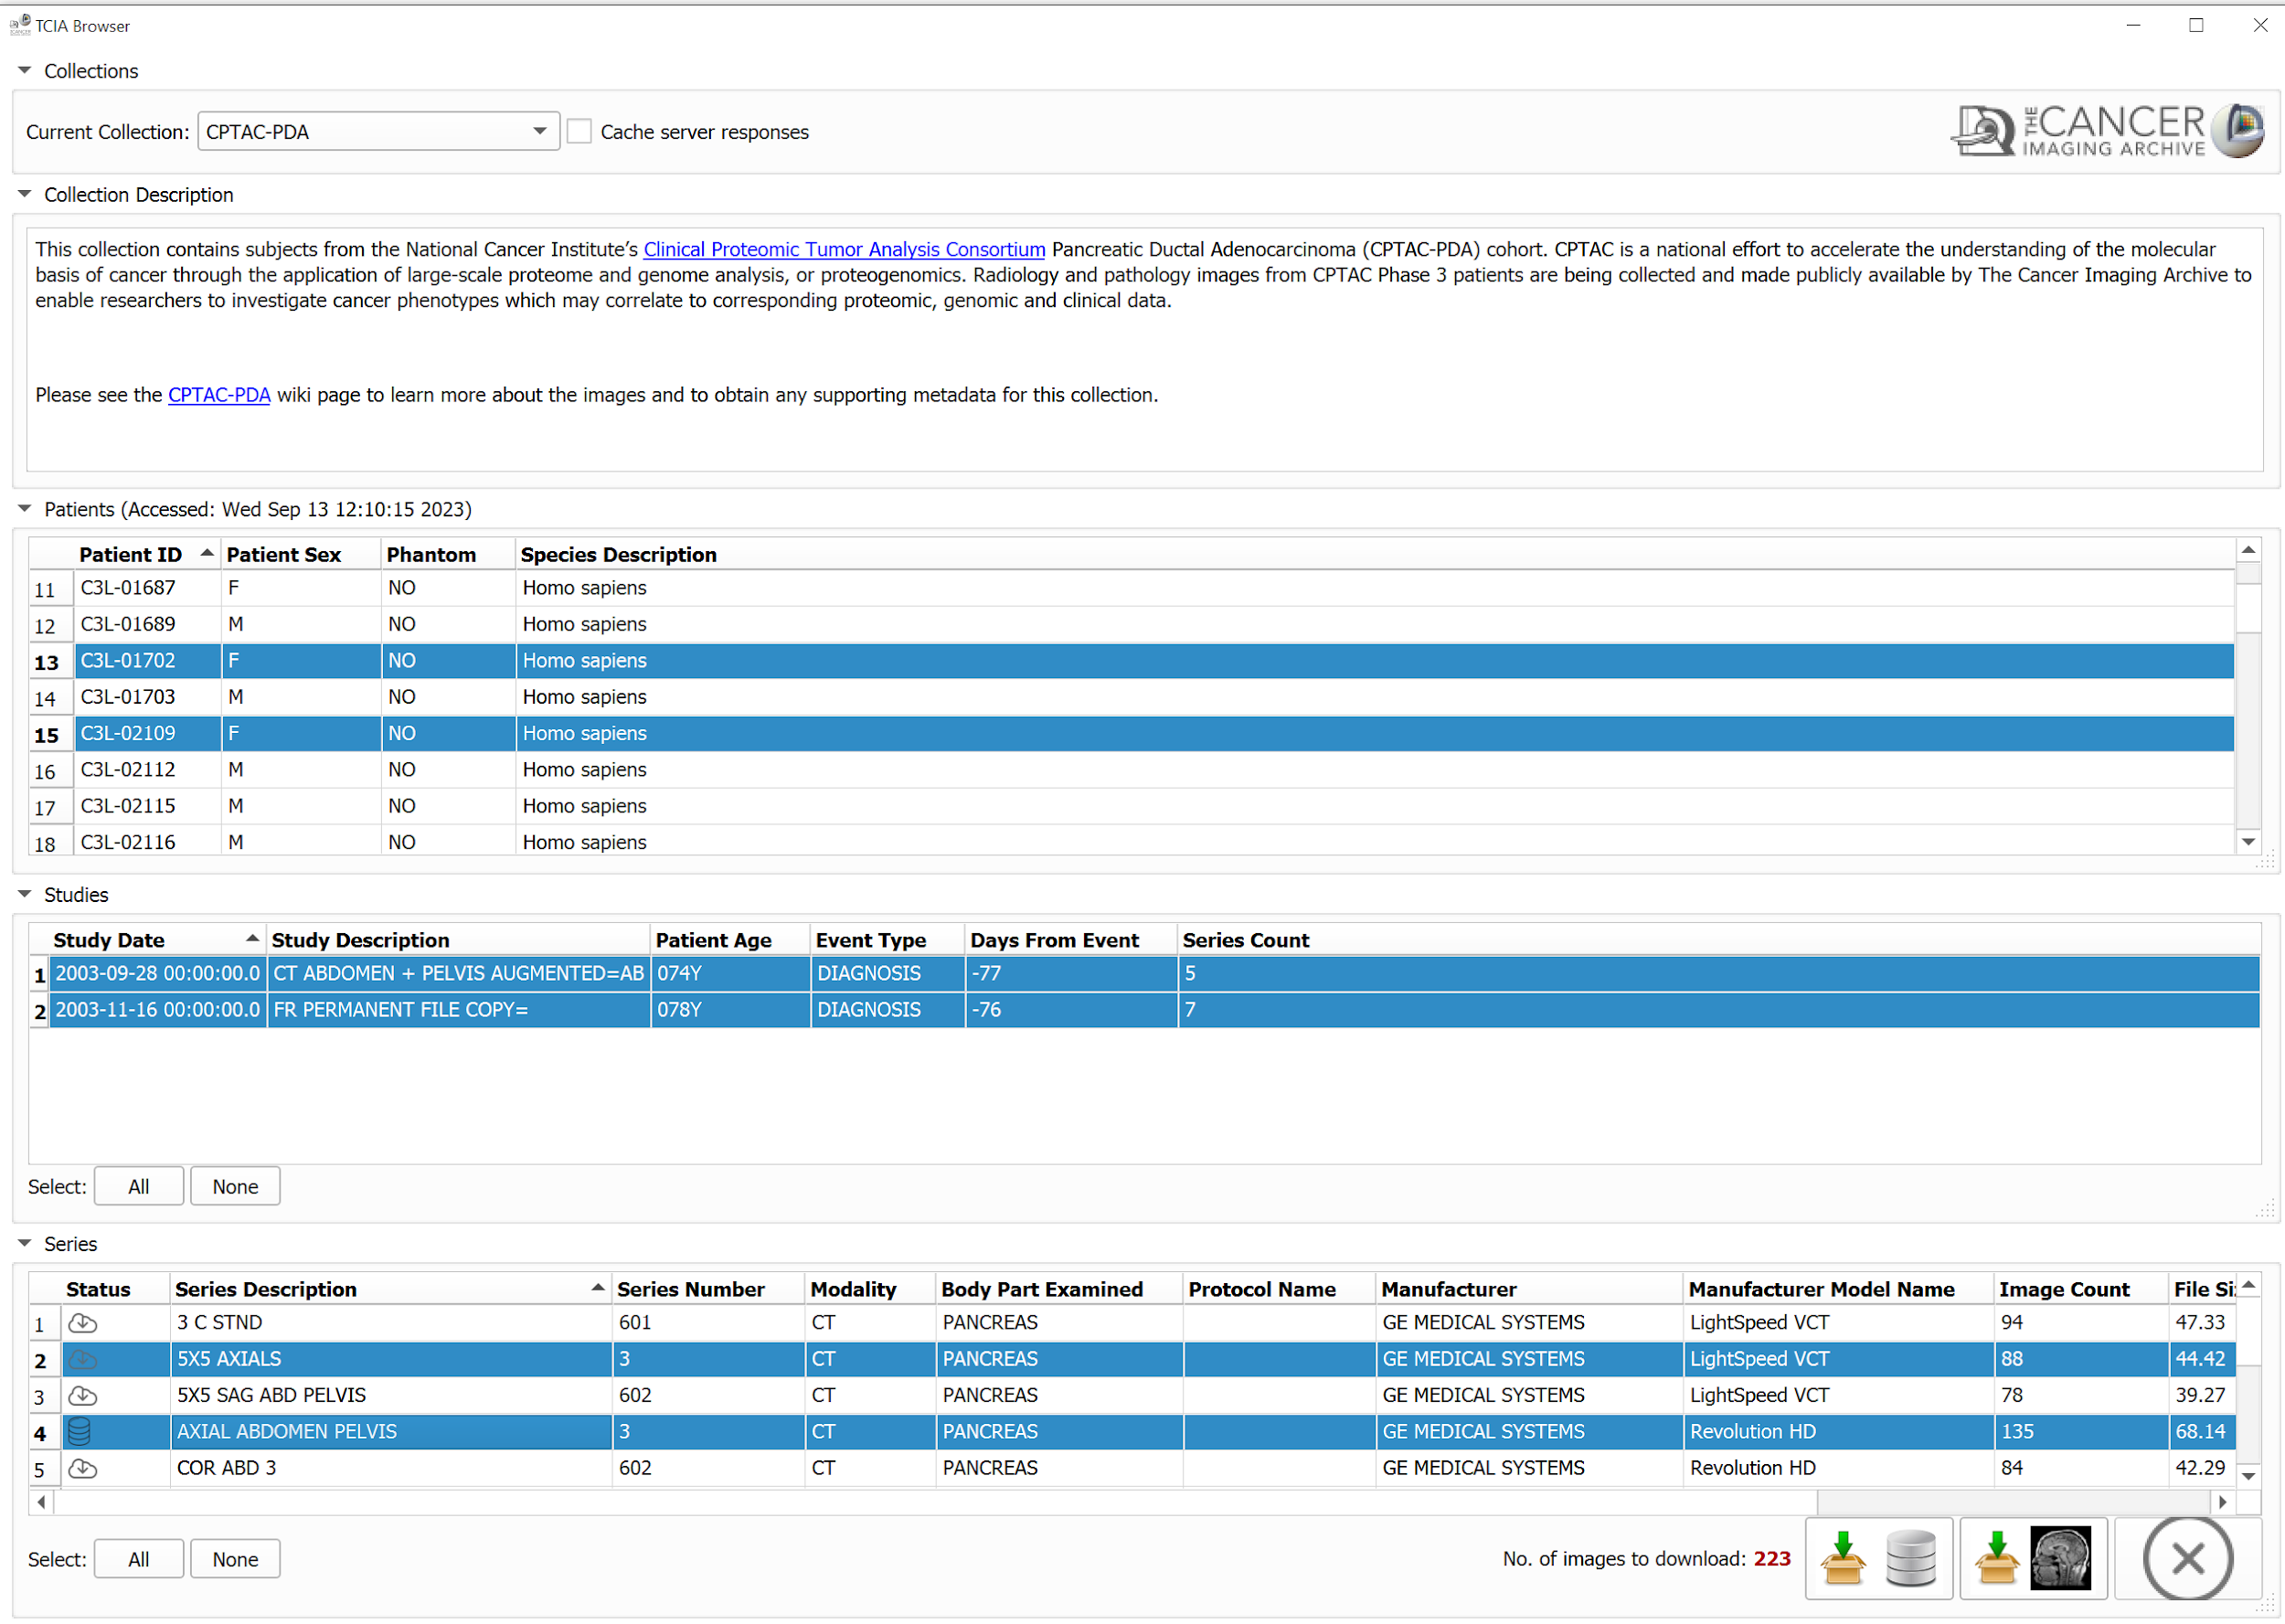

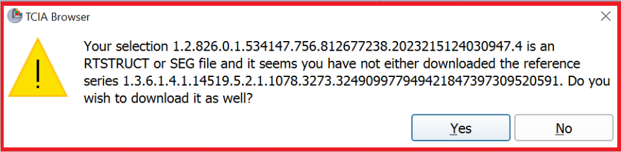
TCIA Browser Layout
Select
a Collection
View its description
Select
one or more
Patients
After selecting the data you’re interested in you can choose between downloading the data into Slicer’s DICOM database for later use, or immediately loading the scan for viewing.
To select multiple rows from any category use CTRL + SHIFT to select a number of rows in consecutive order; or hold down the CTRL key and use your mouse to click on desired rows.
The Browser will alert you if RTSTRUCT or SEG files are selected without the referenced series to ensure you have the images that go with these segmentations when available.
Select
Studies
SelectSeries
Status Bar shows the status of each series being downloaded
Download selected series and Index in 3d Slicer database
Download selected series and Load in 3d Slicer Scene
Cancel All Downloads
Hold down and drag right bottom edge to expand individual sections

Slide 7
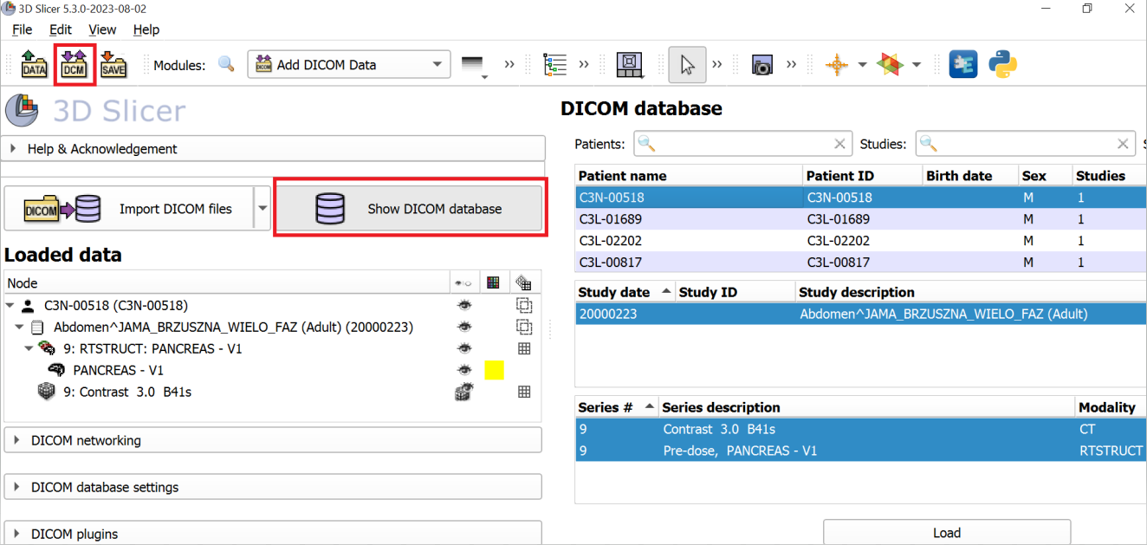
Download and Index in 3D Slicer Database
DICOM Database shows complete list of files downloaded to 3D Slicer
If you chose to download and index the file to the Slicer DICOM database you can view and load what’s been downloaded by clicking the DICOM buttons highlighted in the screenshot on the right.

Slide 8
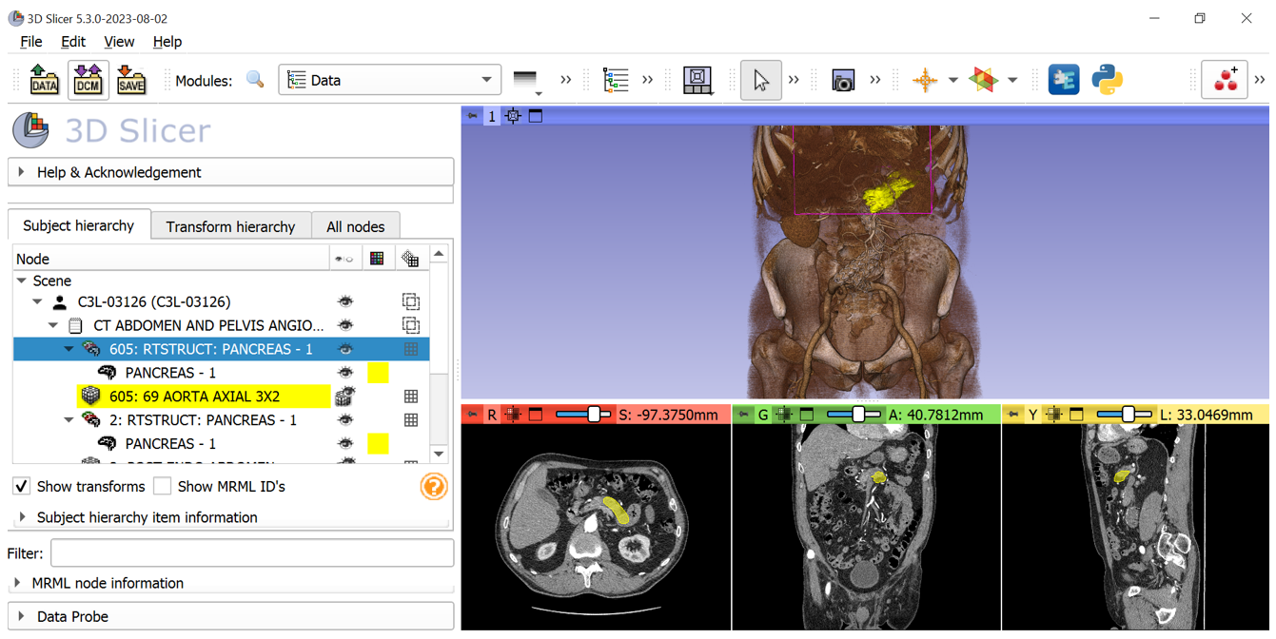

Download and Load
Click on Data Icon
3D View
If you chose to download and load the data to your Slicer Scene it should appear immediately upon completion of the download.
After the download is complete, click on the Data Icon to view the list of files in the current scene.
Current Scene
Axial, Coronal and Sagittal windows

Slide 9
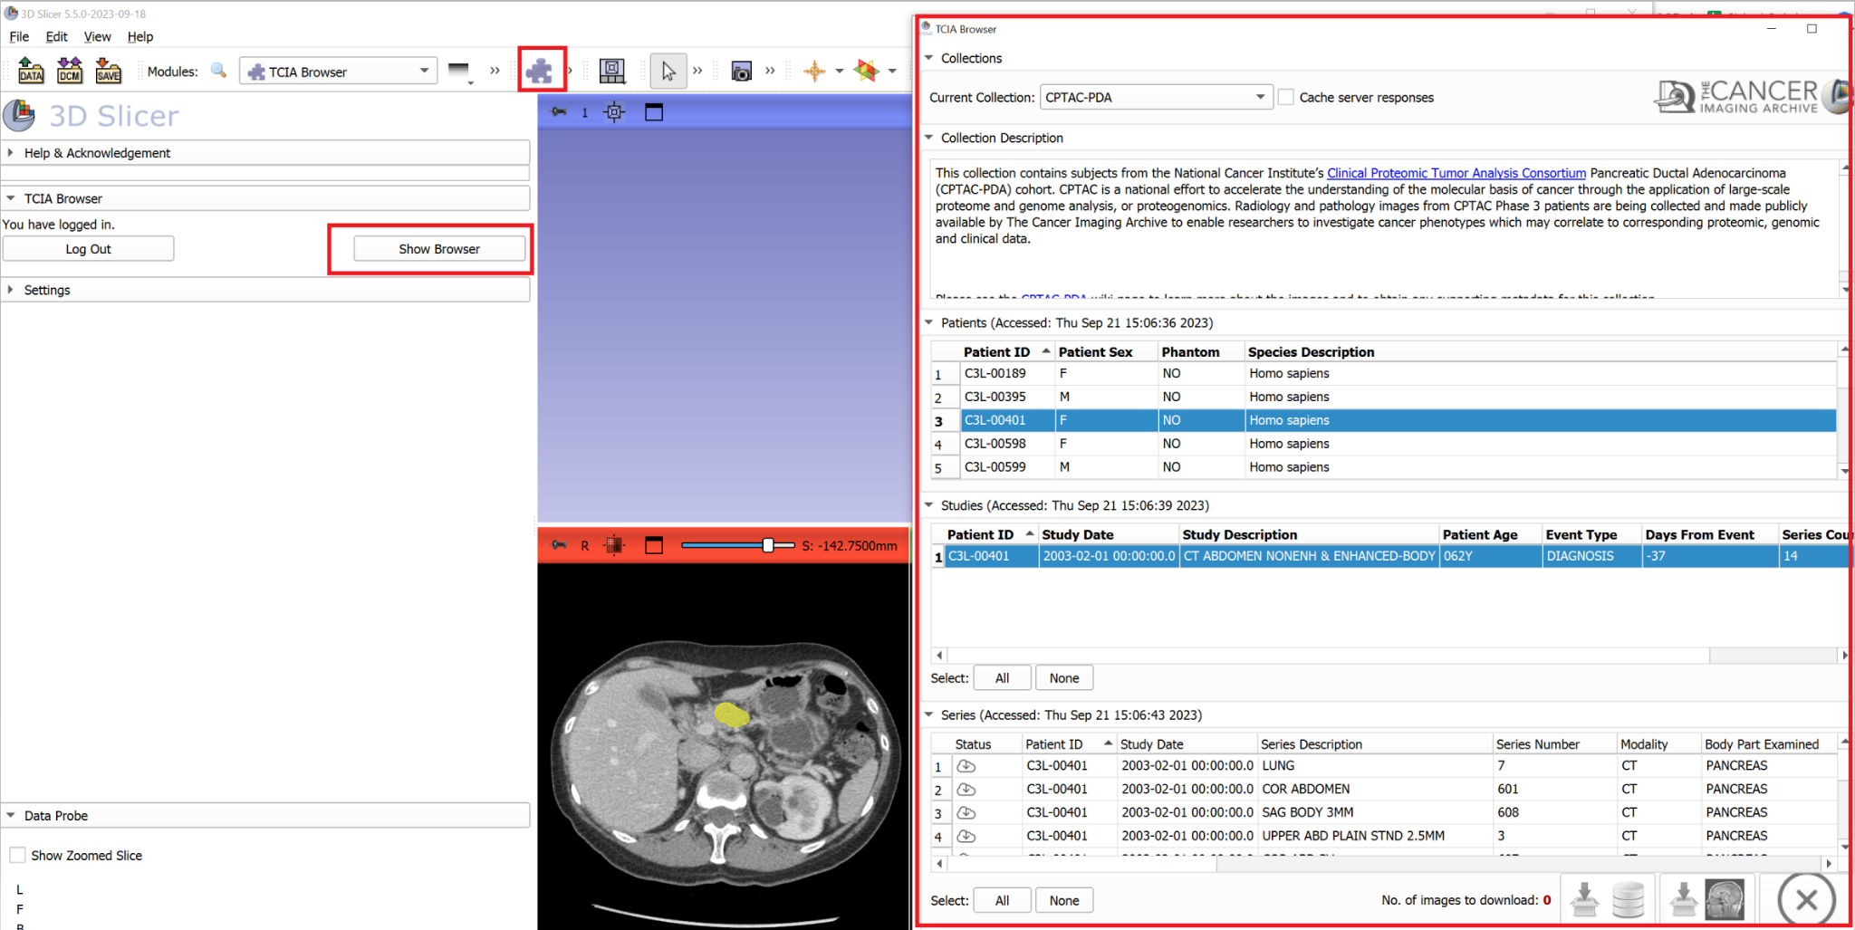
Returning to TCIABrowser
If you’d like to get back to TCIABrowser to download additional data:
Click on the TCIABrowser icon from your Favorites menu
Then click on Show Browser to open the browser window again
If you’ve logged in with your own account to access restricted data, use the logout button when you’re finished

